Slide 1

EditEdit MasterMaster texttext stylesstyles
Practical Lecture 3: Concepts & Basics of C++ Programming

Slide 2

Quick Recap
Let’s take a quick recap of previous lecture –
A) basics of c
B) loops
C)Classes and objects

Slide 3
Today’s Agenda
Today we are going to cover -
C++ Introduction.
Difference b/w C and C++.
Installation
Syntax
Variable
Data Types

Slide 4
Today’s Agenda
Array
String
Function
Programming Practice Questions
MCQ Questions
Revision

Slide 5
C++
Let’s Get Started-

Slide 6
C++ Introduction
C++ is a general-purpose programming language created by Bjarne Stroustrup as an extension of the C programming language, or "C with Classes".
The language has expanded significantly over time, and modern C++ now has object-oriented, generic, and functional features in addition to facilities
for low-level memory manipulation. It is almost always implemented as a compiled language

Slide 7
C++ Introduction
C++ supports the object-oriented programming, the four major pillar of object-oriented programming (OOPs) used in C++ are: paradigm
Person – student Inheritance :-In C++, inheritance is a process in which one object acquires all the properties and behaviors of its parent object automatically. In such way, you can reuse, extend or modify the attributes and behaviors which are defined in other class. ... The derived class is the specialized class for the base class
Parent/Super/Base- Child/sub/Derived

Slide 8
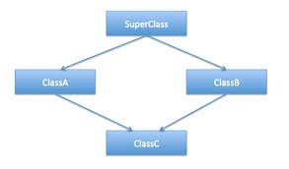
C++ Introduction

Slide 9
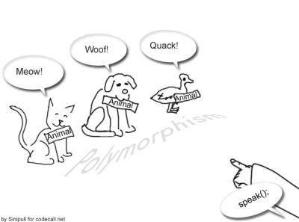
C++ Introduction
Polymorphism:-Polymorphism means "many forms", and it occurs when we have many classes that are related to each other by inheritance.
Add (int, int)
Add(float, float)
Add(string, string)

Slide 10
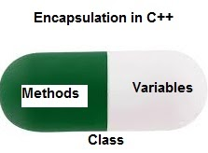
C++ Introduction
Encapsulation:-In object-oriented programming (OOP), encapsulation refers to the bundling of data with the methods that operate on that data, or the restricting of direct access to some of an object's components(data). ... Publicly accessible methods are generally provided in the class to access or modify the state more abstractly.

Slide 11
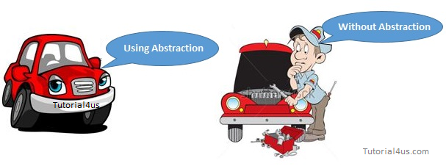
C++ Introduction
Abstraction:-Data Abstraction is a process of providing only the essential details to the outside world and hiding the internal details, i.e., representing only the essential details in the program. Data Abstraction is a programming technique that depends on the seperation of the interface and implementation details of the program.

Slide 12
Usage Of C++
By the help of C++ programming language, we can develop different types of secured and robust applications:
Window application
Client-Server application
Device drivers
Embedded firmware

Slide 13
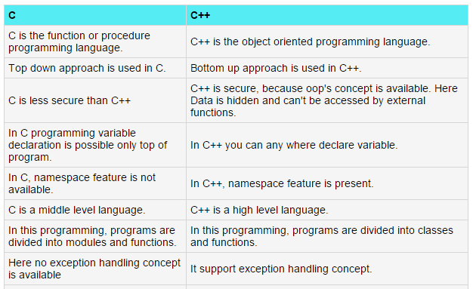
Difference b/w c and C++.

Slide 14
Installation
On Visual Studio code:-https://code.visualstudio.com/docs/languages/cpp
One Code Blocks:-https://www3.ntu.edu.sg/home/ehchua/programming/howto/CodeBlocks_HowTo.html

Slide 15
Hello World in C++
#include<iostream>
using namespace std;
int main()
{
cout<<"Hello World!";
return 0;
}

Slide 16
Variables in C++
A variable is a name which is associated with a value that can be changed. For example when I write int num=20; here variable name is num which is associated with value 20, int is a data type that represents that this variable can hold integer values.
Types of variable:-
int: These type of of variables holds integer value.
char: holds character value like ‘c’, ‘F’, ‘B’, ‘p’, ‘q’ etc.
bool: holds boolean value true or false.
double: double-precision floating point value.
float: Single-precision floating point value.

Slide 17
Variable Scope
1. Global variable:-A variable declared outside of any function (including main as well) is called global variable. Global variables have their scope throughout the program, they can be accessed anywhere in the program, in the main, in the user defined function, anywhere.
2. Local variable:-Local variables are declared inside the braces of any user defined function, main function, loops or any control statements(if, if-else etc) and have their scope limited inside those

Slide 18
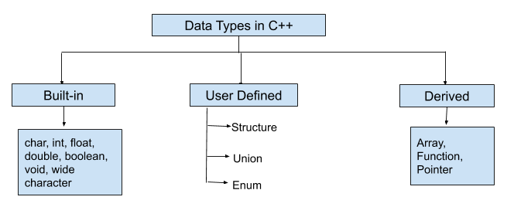
Data Types
A data type or simply type is an attribute of data which tells the compiler or interpreter how the programmer intends to use the data. ... This data type defines the operations that can be done on the data, the meaning of the data, and the way values of that type can be stored.

Slide 19
Practice Question's
Write a program to swap two number without using third variable.
Write a program to find the size of all the data types.

Slide 20
Conditionals:-
Sometimes we need to execute a block of statements only when a particular condition is met or not met. This is called decision making, as we are executing a certain code after making a decision in the program logic. For decision making in C++, we have four types of control statements (or control structures), which are as follows:
a) if statement
b) nested if statement
c) if-else statement
d) if-else-if statement

Slide 21
Practice Question's
Write a program to check whether a number is prime or not.
Write a program to print the greatest among the three numbers entered by the user.
Write a program to check whether the year is leap or not.
Write a program to check whether the number is palindrome or not.
12321
naman

Slide 22
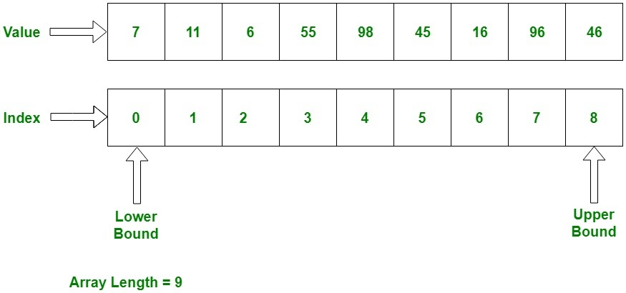
Array
An array is a collection of similar items stored in contiguous memory locations. In programming, sometimes a simple variable is not enough to hold all the data. For example, let's say we want to store the marks of 500 students, having 500 different variables for this task is not feasible, we can define an array with size 500 that can hold the marks of all students

Slide 23
Declaring array
Method 1:-int arr[5];
arr[0] = 10;
arr[1] = 20;
arr[2] = 30;
arr[3] = 40;
arr[4] = 50;
Method 2:-
int arr[]= {10, 20, 30, 40, 50};
Method 3:-
int arr[5] = {10, 20, 30, 40, 50};

Slide 24
Accessing Array
#include <iostream>
using namespace std;
int main(){
int arr[] = {11, 22, 33, 44, 55};
cout<<arr[0]<<endl;
cout<<arr[1]<<endl;
cout<<arr[2]<<endl;
cout<<arr[3]<<endl;
cout<<arr[4]<<endl;
return 0;
}

Slide 25
Practice Questions
1.Write a program to print the sum and product of all the number in the given array.
2.Write a program to find the greatest number in the array.

Slide 26
Strings
A string is a data type used in programming, such as an integer and floating point unit, but is used to represent text rather than numbers. ... For example, the word "hamburger" and the phrase "I ate 3 hamburgers" are both strings. Even "12345" could be considered a string, if specified correctly.
char name[15];
#include <iostream>
#include <string>
using namespace std;
int main() {
string enterText;
cin>>enterText;
cout << enterText;
return 0;
}

Slide 27
Practice Questions
Write a program to find the frequency of character in the string .
sdfhjdsfy
d=2
Write a program to reverse a string.
asda
adsa

Slide 28
Functions
A function is block of code which is used to perform a particular task, for example let’s say you are writing a large C++ program and in that program you want to do a particular task several number of times, like displaying value from 1 to 10, in order to do that you have to write few lines of code and you need to repeat these lines every time you display values. Another way of doing this is that you write these lines inside a function and call that function every time you want to display values. This would make you code simple, readable and reusable.

Slide 29
Function
#include <iostream>
using namespace std;
/* This function adds two integer values
* and returns the result
*/int
sum(int num1, int num2){
int num3 = num1+num2; return num3;
}
int main(){
//Calling the function
cout<<sum(1,99);
return 0;
}
.

Slide 30
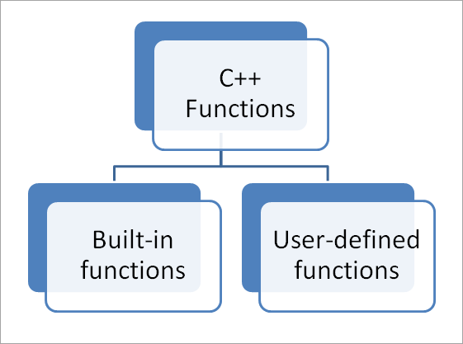
Function

Slide 31
Build In Function
#include <iostream>
#include <cmath>
using namespace std;
int main() {
double num, squareRoot;
cout << "Enter number: ";
cin >> num;
squareRoot = sqrt(num);
cout << "The square root of " << num << " is: " << squareRoot;
return 0;
}

Slide 32
User Defined Function
#include <iostream>
using namespace std;
void sayHello() {
cout << "Hello!";
}
int main() {
sayHello();
return 0;
}

Slide 33
Practice Questions
Define a function that returns the product of two numbers entered by user.
Write a program to print the circumference and area of a circle of radius entered by user by defining your own function.
A person is elligible to vote if his/her age is greater than or equal to 18. Define a function to find out if he/she is elligible to vote.

Slide 34
Practice Questions
Write a program which will ask the user to enter his/her marks (out of 100). Define a function that will display grades according to the marks entered as below:
Marks Grade
91-100 AA
81-90 AB
71-80 BB
61-70 BC
51-60 CD
41-50 DD
<=40 Fail

Slide 35
Revision
What is difference between c and c++?
What is oop's concept?
What is function explain user defined and pre-defined function.

Slide 36
Assignment For You
C++ Program to Find the Number of Vowels, Consonants, Digits and White Spaces in a String.
C++ Program to Check Armstrong Number 1234
In the case of an Armstrong number of 3 digits, the sum of cubes of each digit is equal to the number itself. For example, 153 is an Armstrong number because
153%10=rem=3
Sum=sum+pow(rem,3)
153/10=15=n
153 = 1*1*1 + 5*5*5 + 3*3*3
C++ Program to Concatenate Two Strings
Hello
World
HelloWorld

Slide 37

QNA Time
Any Questions??
Any Questions ??

Slide 38
Thank You!
See you guys in next class.

